Slide 1

ChibiOS/RT Tools Setup
A free embedded RTOS
http://www.chibios.org

Slide 2
Software Setup
Please check the ChibiStudio toolchain installation
The toolchain has to be installed in C:\ChibiStudio for simplicity
There are some USB drives available for those who don’t have the toolchain already installed

Slide 3
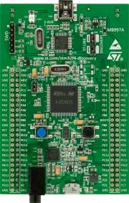
Hardware Setup
Check STLink drivers installation, drivers are available within the toolchain
Connect your board to the PC using an USB-mini cable
Verify that it appears in the Windows Device Manager
There are some spare boards available for those who don’t have one

Slide 4

End of Tools Setup

